Slide 1
Business and Industrial Economics
Prof. Luca Grilli
Public goods

Slide 2
Public goods
Positive externality stretched at the maximum
What is a public good?
Non-excludability from consumption
Non-rivalry in consumption
Ex: Street Lighting, Pedestrian Walk, Defense, Clean air.
……An economic (rather than a political or technical) concept:
it’s public nature depends on its intrinsic characteristics
Do we have the technical capability to exclude non-payers from non rival goods consumption?
If technically possible, is it economically feasible?
(Pedestrian walks with gates?)
…..Once provided, quantity of the public good is the same for everyone by definition

Slide 3
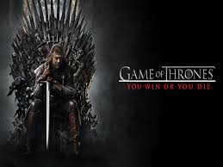

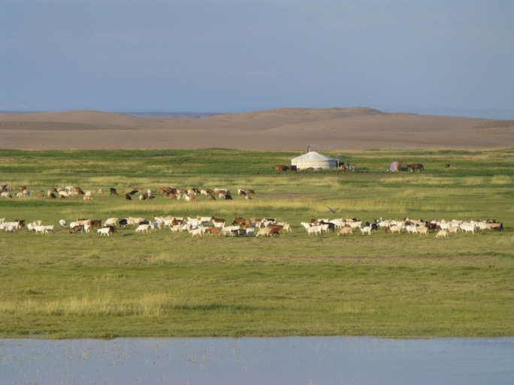
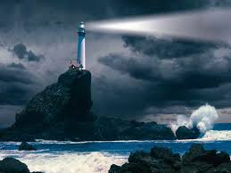
Basic Taxonomy
 | Rival | Non rival
Excludable
Non excludable
Private goods
«Club» goods
Commons
Public goods

Slide 4
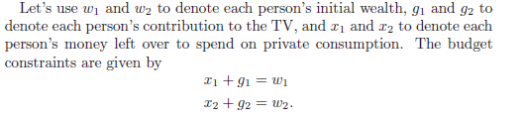
When to provide a public good?
- Suppose 2 roommates, 1 & 2
- Whether or not to purchase a TV
Given the size of the apartment, TV in the living room: both roommates will be able to watch it. TV is a public good.
Question: is it worth for them to buy the TV?

Slide 5
We suppose that the TV costs c, so in order to purchase the TV, the sum of the contributions must be at least c:
Utility of Person 1:
Utility of Person 2:
Reservation price (i.e. willingness to pay) of Person 1 for the TV (utility he gets from paying TV and watch it equal to utility he gets from not paying and not watching):
Reservation price of Person 2 for the TV: analogous

Slide 6

In this TV problem, there are 2 allocations of interest:
1) Each person spends his wealth only on his private consumption:
2) They decide to buy the TV:
When the TV will be provided?
Surely when allocation 2) Pareto dominates allocation 1). This means:

Slide 7



Using reservation prices and budget constraint we can write:
Therefore, it has to be:
Which in turn it implies:
and:
Allocation 2) will be Pareto dominant if each reservation price is greater than each payment and the total amount that the roommates are willing to pay is at least as large as the cost of the purchase.

Slide 8
This is so straightforward you may ask why we have been through all these mathematical formalisms for this intuitive result
For 1 reason:
In the real world, the reservation price (willingness to pay) of each person depends on his/her personal wealth
Whether or not to provide a public good, will depend on reservation prices and in turn on the distribution of wealth among members of a community

Slide 9
It is perfectly possible that for some wealth dbns: for others:
EXAMPLE
Imagine a situation where one roommate really loves the TV and the other roommate is nearly indifferent about acquiring it. Then if the TV-loving roommate had all of the wealth, he would be willing to pay more than the cost of the TV all by himself. Thus it would be a Pareto improvement to provide the TV. But if the indifferent roommate had all of the wealth, then the TV lover wouldn’t have much money to contribute toward the TV, and it would be Pareto efficient not to provide the TV.

Slide 10
What is the problem with the provision? The free-riding problem
Suppose reservation prices exceed personal payments and the sum of personal payments is enough to cover the cost of the good. Thus allocation 2) is Pareto efficient. Are we sure that this equilibrium will emerge? Of course not……..
Suppose each person has a wealth of 500 €.
Suppose each person values the TV at 100 €.
Suppose that the cost of the TV is 150 €.
Suppose that there is no way for one of the roommates to exclude the other one from watching (as before).
But now suppose that each roommate has to decide independently from the other whether or not to buy the TV
(and having 2 TV sets is totally useless).

Slide 11
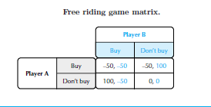
Free rider Person who receives the benefit of a good but avoids paying for it
1 Nash eq. (Don’t buy; Don’t buy)
Here the game is trivial but it makes the point: each player has an incentive to free-ride on the expenditure of the other (since by doing this, it enjoys the TV without paying anything). But if both players think in this way the result is that the good will not be provided, even if the scenario where TV is bought and the payment is equally shared is a Pareto improvement.
In reality we can expect things not to unfold in this way (2 roommates are friends, contribute equally, and the TV will be bought). But in other circumstances the possibility to free-ride may become more likely and “no provision” a serious possibility.
Who can solve the problem? Government can remedy:
Providing the public good and paying it with tax revenues
But still problems with free riders in paying taxes

Slide 12
How much of a public good? How to decide?
Complex issue
By definition the public good has to be provided in the same quantity for all individuals, even though all individuals have different preferences regarding their “perfect” quantity. But “one size should fit all”.
In principle, one could collect the willingness to pay/contribute of each individual for different quantities (e.g. with exit polls) or present individuals with different options to choose from, for then making them vote on the preferred size.
But still problems:
How to collect trustable and credible “willingness to pay” by citizens?
Voting is not perfect (e.g. social preferences may not be transitive)
At the aggregated social level:
x > y, y > z, z > x
This is a version of the “Condorcet Paradox” from which Arrow started his reasoning that led him to the so-called “Impossibility theorem”

Slide 13
Brief excursus (from Varian): Arrow’s impossibility theorem

Slide 14

Text
General question (example). Vaccines
Using the concepts of the BIE course, describe from an economic perspective what type of economic good the vaccine is, its nature and its characteristics.
Indeed, vaccines shows a great (positive) externality component but they are not a “public good” in pure economics terms.
Herd immunity is.
See: Why Government Should Spend More On Public Goods (forbes.com).

Slide 15
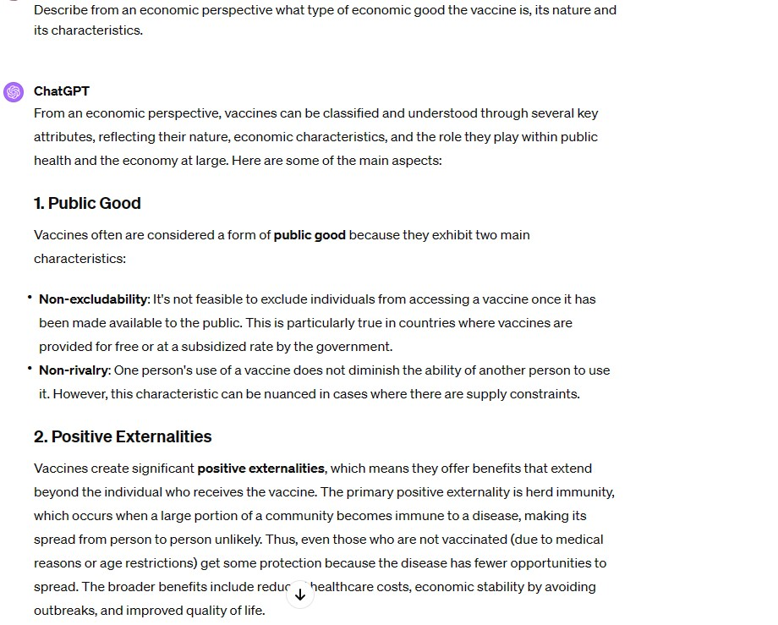
Extract from the ChatGPT-4 answer (15/03/2024)
wrong
Wrong
Wrong
Not well-said

Slide 16
References
Varian (Intermediate Microeconomics, chapters 34.1, 37, 37.1, 37.2, 37.3).

Slide 17
Business and Industrial Economics
Prof. Luca Grilli
Common goods

Slide 18
What’s the problem with “commons”?
“Commons”: common grazing land when the villagers graze their cows on a common field.
Individuals are free to graze their cows in the field with no restrictions
Hardin (1968): This situation typically determines the so-called tragedy of the commons, i.e. over-exploitation of the field.
Any villager is tempted to graze more than his / her (hypothetical) share
If all succumb to the same temptation, the grass ceases to grow and the value of the pasture to everybody disappears.

Slide 19
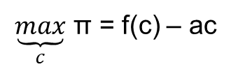
Each villager has to decide how many cows bring to graze.
c is the number of cows, each cow costs a.
y (milk) = f(c) with f’(c) > 0 and f’’ (c) < 0.
Villagers are price takers: p of a liter of milk = 1 €
MR = MP
(talking about value or product is the same)
A. Private property (one villager owns the field and decide how many cows enter)
$\underset{c}{\underbrace{max}}$ π = f(c) – ac
f.o.c.: f’(c*) = a
if f’(c) > a, a new cow will enter; if f’ (c) < a, a cow will exit, eq.: f’(c*) = a
B. Commons (none owns the field, everybody can freely enter with cows)
Suppose that there are c cows currently being grazed so that the current output per cow is equal to f(c)/c. When a villager contemplates if adding a new cow, (s)he will compare f(c+1)/(c+1) > a. If this inequality is verified, the new cow will be added; otherwise not. It follows that the total number of cows will be a specific c^ that verifies f(c^)/c^ = a. This c^ is certainly greater than c*.

Slide 20
Graphically

Slide 21
Exam 21st June 2019

Slide 22
Remedies?
Yes in some circumstances, by acting on the “non-excludability” characteristic, i.e. making them less “freely available”.
Transforming the common into a private good (enforce excludability) with precise definition of property rights. Private property provides such a mechanism. Indeed, if the field is owned by someone who can control its use and, in particular, can exclude others from overusing it, then there are by definition no externalities. The market solution leads to a Pareto efficient outcome (and surely dominant with respect to a situation where the good has become totally useless to everyone because it has been over exploited).
Of course, private property is not the only social institution that can encourage efficient use of resources. As Hardin (1968, p. 1245) notes “we might keep them as public property, but allocate the right to enter”. Nobel prize Elinor Omstrom defined 8 managing principles for governing commons in her famous book Governing the commons, 1990, freely available in Internet). For example, rules could be formulated about how many cows can be grazed on the village common. If there is a legal (or strong social) system to enforce those rules, this may be an alternative solution for providing an efficient use of the common resource.

Slide 23
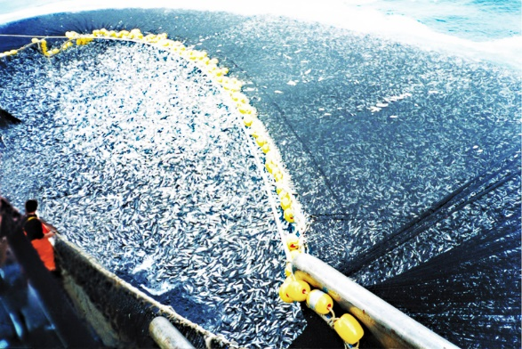
Overfishing
But not in every circumstances
However, in situations where excludability mechanisms are not implementable and the law is ambiguous/difficult to enforce, the tragedy of the commons can easily arise. Overfishing in international waters is an example: each fisherman has a negligible impact on the total stock of fish, but the accumulated efforts of thousands of fishermen results in serious depletion.

Slide 24
When “Commons” are left “Commons”, and formal institutions (rules, laws, norms) are unable to enforce restrictions, their survival will crucially depend on whether informal institutions characterizing a society (culture, sense of belonging to a community) are strong enough
[…] An appeal to conscience […] (can produce) two communications,
and that they are contradictory:
(i) (intended communication) "If you don't do as we ask, we will openly condemn you for not acting like a responsible
citizen"; (ii) (the unintended
communication) "If you do behave as we ask, we will secretly condemn you for a simpleton who can be shamed
into standing aside while the rest of us exploit the commons."
In these situations, social (i.e. solidaristic) values have to prevail in order to make things work
Hardin, 1968, p. 1246

Slide 25
References
Varian (Intermediate Microeconomics, chapter 35.6).
Further (optional) reading (ever-green classic):
G. Hardin, The tragedy of the commons, Science, 1968, vol. 162, pp. 1243-1248.

